Slide 1

Fundamentals in Biophotonics
Aleksandra Radenovic
aleksandra.radenovic@epfl.ch
EPFL – Ecole Polytechnique Federale de Lausanne
Bioengineering Institute IBI
17.02.2025.

Slide 2
Plan for the class
WHO?
Lectures: Aleksandra Radenovic (aleksandra.radenovic@epfl.ch)
Exercises:
Wei Guo (wei.guo@epfl.ch)
WHEN and WHERE?
Lectures: Mondays 10.15– 12.00
Exercises: problem sets that will follow after 2nd week
Moodle : https://moodle.epfl.ch/course/view.php?id=15044
Grade during the semester homework and flipped classroom

Slide 3
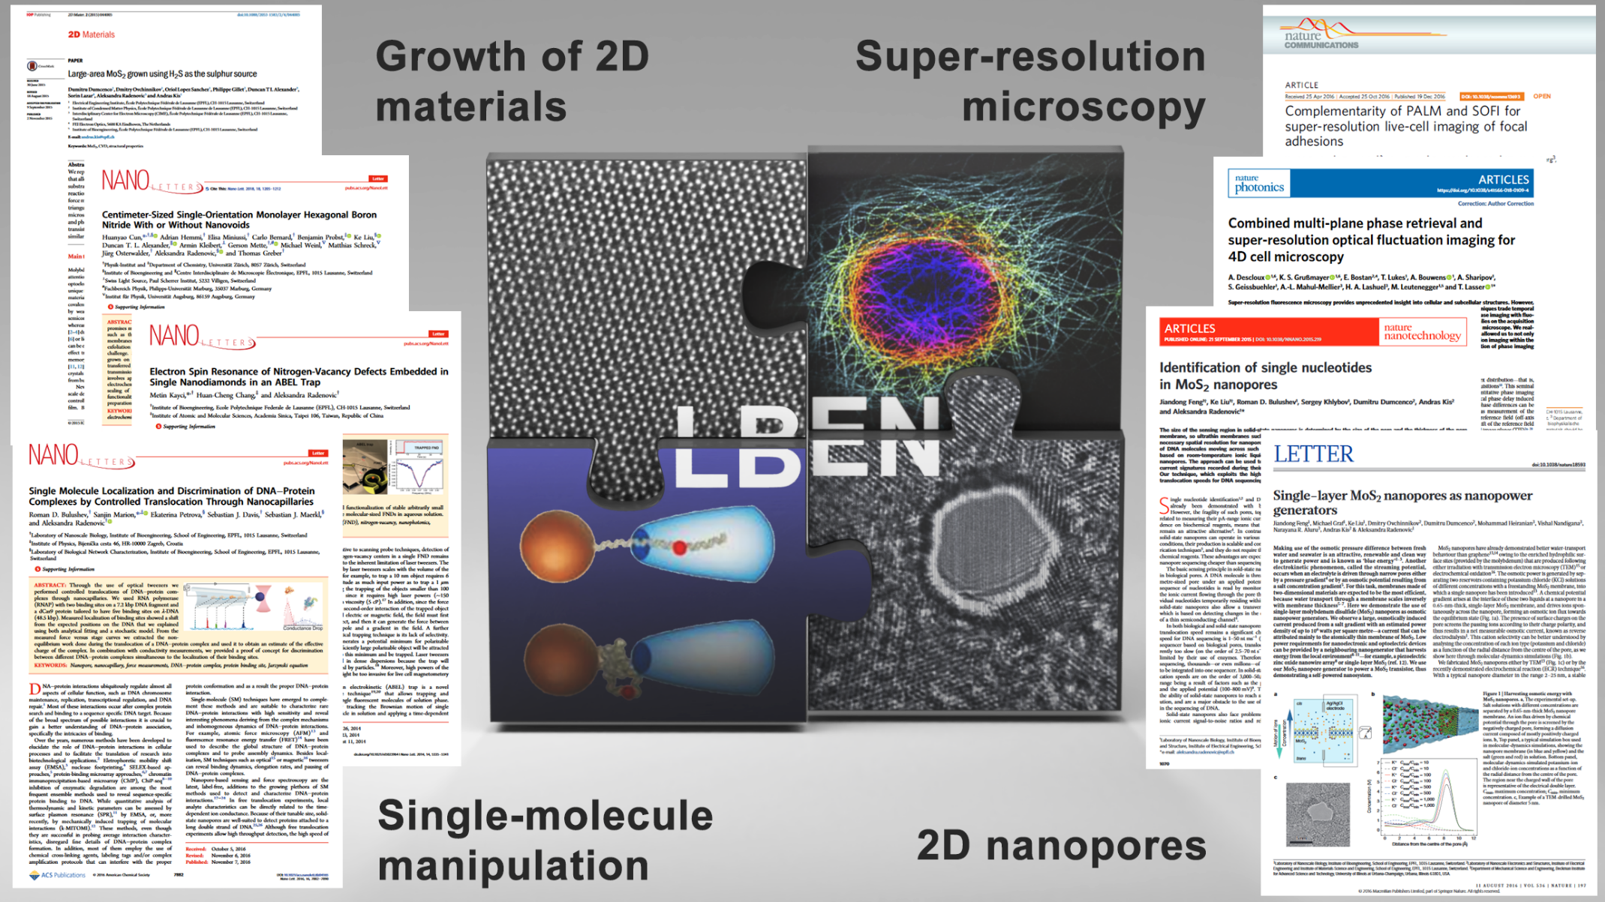
Prof Radenovic
Office hours 14-15.00 every Friday –for Prof Radenovic and Wei Guo
E mail alakesandra.radenovic@epfl.ch
Lab LBEN

Slide 4
YOU

Slide 5
Schedule
https://docs.google.com/spreadsheets/d/1rYpU327ekuptJWSO3Ve7fA2KkFle4t6n/edit?gid=483657210#gid=483657210
Presentation schedule
Date |  | 1st Student | Assigned Topic | 2nd Student | Assigned Topic | 3nd Student | Assigned Topic
17.02.2025. |  | INTRO SESSION
24.02.2025 |  | Selection of the topics /schedule of the topics /material preparation /No Class
03.03.2025. |  | Lecture 1
10.03.2025. |  | Lecture 2
17.03.2025. |  | Lecture 3
23.03.2025. |  | Lecture 5
31.03.2025. |  | Lecture 6
07.04.2025. |  | Lecture 7
14.04.2025. |  | Lecture 8
21.04.2025 |  | Easter holidays(Vacances) Easter Monday(Jour férié)
28.04.2025.
05.05.2025.
12.05.2025.
19.05.2025.
26.05.2025.

Slide 6
TOPICS
EndoscopicTecnniques_1
OCT
Latice_light
Single cell quantitative measurements_1
Single cell quantitative measurements_2
Optical tweezers 1
Optical tweezers 2
Optogenetics_1
Optogenetics_2
SMLM
FSTORM-blinking
PAINT
DNAnano
SIM
STED

Slide 7
Outline
Total 13 weeks
Fundamentals of Light and Matter 2 weeks
Introducing basic concepts :
Light as photons carries energy
Light as waves exhibits interference and diffraction consequences/applications phase contrast microscopy optical coherence tomography
Light propagation in a medium is dependent on its optical characteristics -consequences/applications in spectroscopy and fluorescent microscopy
(Born and Wolf)
Fundamentals of matter - the concept that electron energies in atoms and molecules have only certain permissible discrete values and conditions called quantization of energies (electronic, vibrational, rotational and translational)
Its (electronic, vibrational) significance to biophotonics / spectroscopy , bioimaging, biosensing , photodynamic therapy , and biomaterials for photonics
Qualitative demonstrate the use of Schrödinger equation to obtain energy levels
Bonding in organic molecules σ and π
π electron delocalization effect in conjugated structures its importance in understanding spectroscopy and fluorescence behavior of fluorophores used in bioimaging and biosensing

Slide 8
Outline
Fundamentals of Light and Matter interaction 2 weeks
Absorption Beer-Lambert’s law ( absorbance, transmittance, optical density )
IR absorption
Refraction
Reflection
Polarization
Spontaneous emission
Simulated emission
Raman scattering
Introduce various spectroscopic approaches (electronic and vibrational )
Introduce spectroscopies that are using optical activity of the chiral media ( circular Dichroism CD, Vibraitonal Circular Dichroism
(conventional basic elements of conventional spectrometer and FT Spectrometer)
Light emission intrinsic and extrinsic
Fluorescence ( fluorescence spectra , lifetime, quantum efficiency , depolarization , introduce concept of dipole emission dipole absorption dipole)
Phosphorescence

Slide 9
Outline
Principles of Laser and Detectors (EMCCD ) 1 week
Lasers (light amplification by stimulated emission radiation) action
Principle
Terminology
Various types of laser /different classification schemes
Non linear optical processes with intense laser beam
Mechanism of frequency conversion
Multiphoton absorption
Detectors EM CCD done
Speed of acquisition
Sensitivity of detection (low light)
Signal detection efficiency (QE)
Size of pixel / frame
Dynamic Range

Slide 10
Outline
Photobiology Interaction of light with cells 1 week
Light absorption in the cells
endogenous ( cell constituents)
exogenous (photosensitizers)
Radiative processes
Autofluorescence (NADH, flavins , aromatic amino acid such as tryptophan tyrosine phenylalanine )
Protein degradation ( photoaddition, photofragmentation , photo-oxidation, photo hydration, cis-trans isomerization, photorearegment)
Principle of photosensitized oxidation process
Nonradiative process
photochemical, excited state chemistry
Photodisruption
Photoablation
Light Scattering
Elastic ( Rayleigh and Mie )
Inelastic ( Brillouin and Raman)
Photosynthesis

Slide 11
Outline
Bioimaging : Principles and Techniques 2 weeks
Utilizes an optical contrast such as difference in light transmission , reflection and fluorescence between the region to be imaged and the surrounding region (background)
Short overview on Optical imaging
Short overview on Optical imaging
Transmission
Fluorescence microscopy
Confocal
Multiphoton
Optical coherence tomography
Near field optical microscopy
FRET imaging
FLIM
Nonlinear optical imaging
SH Microscopy
CARS
Super-resolution

Slide 12
Outline
Bioimaging applications 2 week
Fluorophores as bioimaging markers
Endogenous
Exogenous (fluorophores targeting specific biological molecules without prior coupling and fluorophores that need to be conjugated )
Organ metallic
Near-IR and IR
Two-Photon
Inorganic Nanoparticles (QD etc)
GFP based labeling falls between endogenous and exogenous
Organelle targeting fluorophores
DNA targeting fluorophores -FISH (Fluorescence in situ hybridization)
Probing the Celular Ionic Environment
Ca imaging
pH sensing fluorophores
Two photon tracking of drug cell interactions
Optogenetics

Slide 13
Outline
Tissue imaging
Optical coherence tomography (OCT)
Two-photon excitation laser scanning microscopy (TPLSM)
In vivo imaging
Corneal imaging
Retinal imaging
Optical mammography by NIRF
Catheter based OCT

Slide 14
Outline
Optical Biosensors and Microarray 1 week
Optogenetics 1 week
Labelfree: Surface Plasmon resonance (SPR) and dielectric waveguide methods, biosensors based on whispering gallery modes in microresonators. 1 week
Recapitulation and preparation for exam 1 week

Slide 15
Biophotonics
Biophotonics, the ‘marriage’ between photonics and biology, is an emerging interdisciplinary frontier that deals with interactions between light and biological matter.
Through the integration of four principle technologies, lasers, photonics, nanotechnology, and biotechnology, biophotonics offers immense hope for the early detection and treatment of diseases and for new modalities of light guided and light activated therapies.
Photonics
Biology
Biophotonics

Slide 16
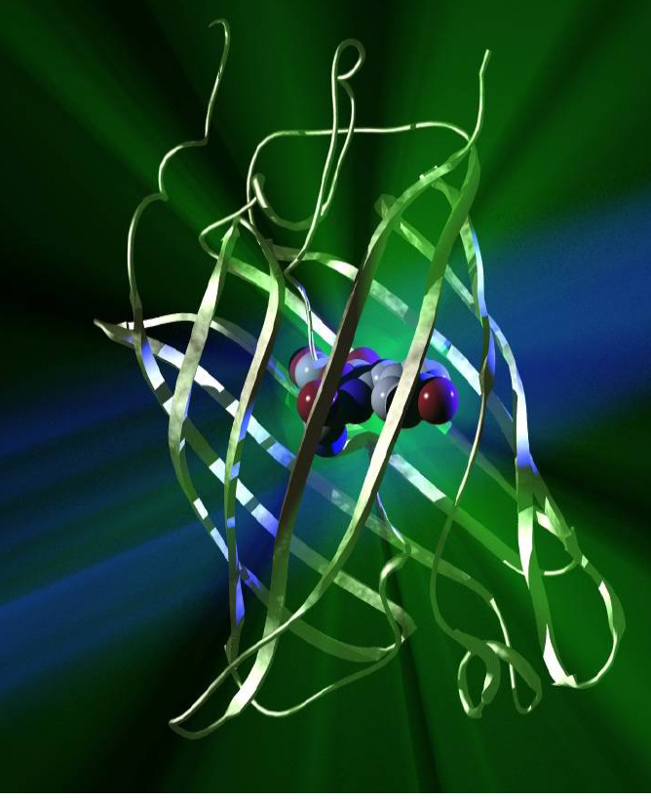
3D-Structure of GFP
“Paint in a can”
Composed of 238 amino acids (27KDa).
Each monomer composed of a central helix surrounded by an eleven stranded cylinder of anti-parallel beta-sheets (shields fluorophore from solvent)
Cylinder has a diameter of about 30 Å and is about 40 Å long
Fluorophore is located on the central helix
Deprotonated phenolate of Tyr66 is cause of fluorescence

Slide 17
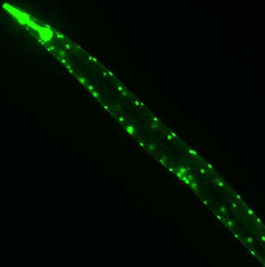
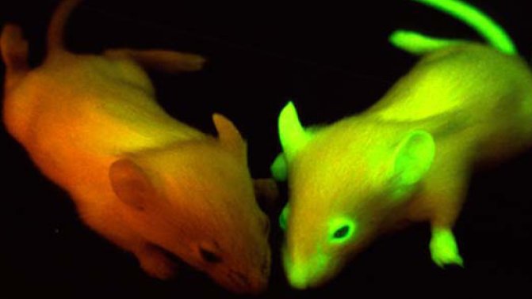
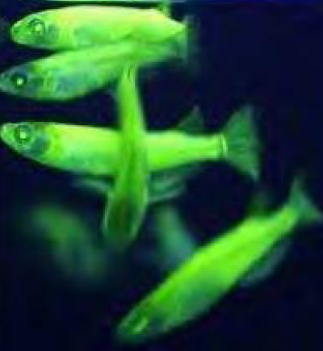
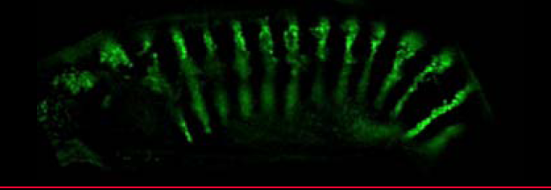
What organisms have been transformed?
bacteria, fungi, Dictyostelium, C. elegans, plants, Drosophila, mammals
C. elegans
Drosophila embryos.

Slide 18
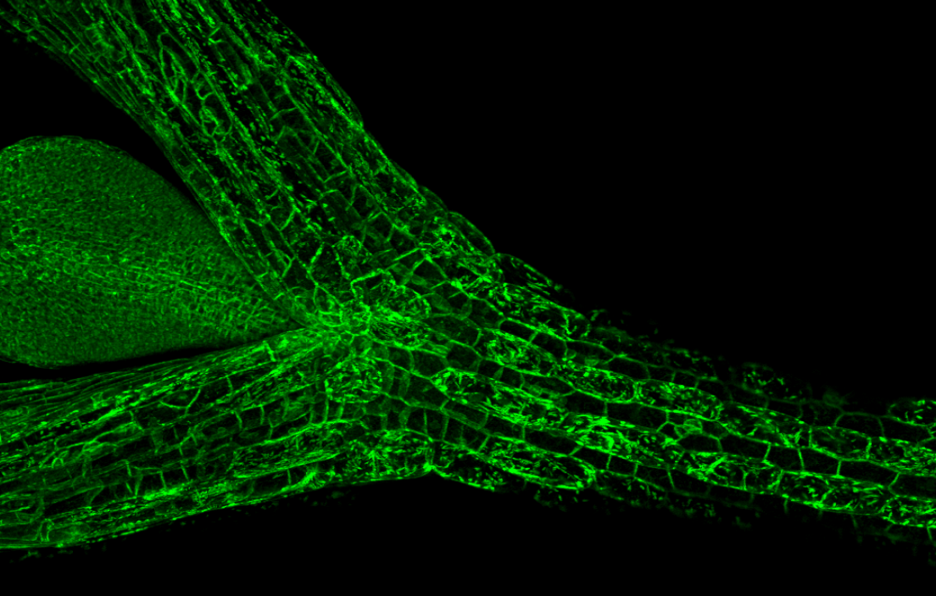
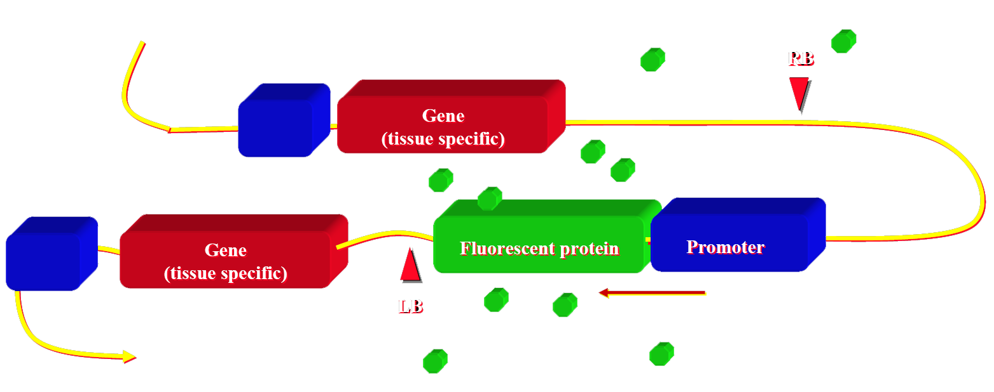
How do we use fluorescent proteins?
Structural studies Genetic modification of an organism for fluorescent protein expression. Promotor can be constitutive or tissue-specific.

Slide 19
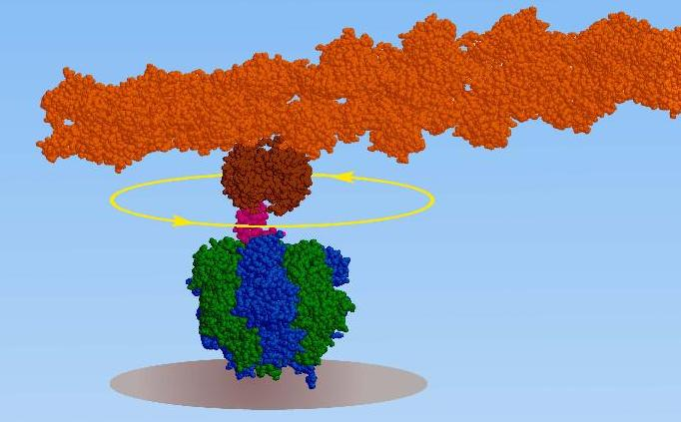
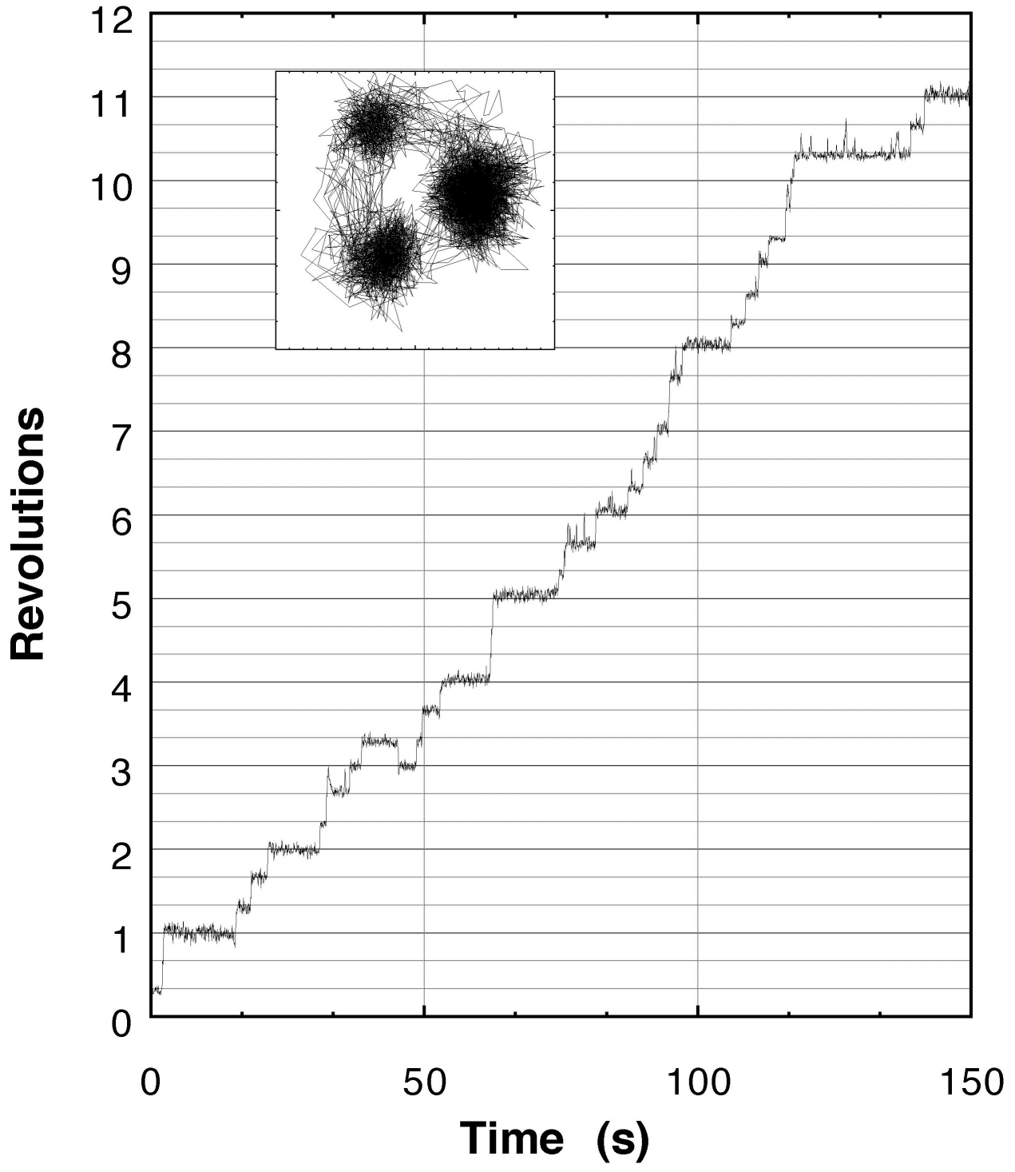

Rotary Molecular motor : The F1- ATP synthetas
The F1-ATPase: a rotationary motor Rotation by 120 steps
The ATP motor/generator is coupled to a proton flux [H+] The F0 and F1 subunits are connected by a shaft γ
The ATP hydrolysis/synthesis occurs on the β subunits
K.Kinosita, Tokyo
Notes:
his process takes place in the mitochondria. A similar process takes place in plants in their chloroplasts, with the difference being their source of energy, sunlight. ATP synthetase or F0F1 ATPase, a large complex of polypeptide chains synthesizes ATP using the flow of protons down an electrochemical gradient while also using ATP hydrolysis to pump protons across the inner mitochondrial membrane; thus it is a reversible coupling device. Both the F1 and F0 portions are rotary motors. The F1 has been structurally characterized and is made up of 3a and 3b subunits arranged around the g subunit (Fig 4), which contacts the F0 part which is membrane bound. Very recently, Itoh et al. [16] presented direct evidence for the chemical synthesis of ATP driven by mechanical energy by attaching a magnetic bead to the g-subunit of F1-ATPase and rotating it. Rotation in the appropriate direction resulted in ATP production. The rotary activity of F1-ATPase has been harnessed to develop motor prototypes by several groups. Noji et al. [17] visualized rotation by attaching an actin filament to the F1 ATPase and a similar example is shown in figure 5, which is an artistic rendering of a hybrid nano-propeller system fabricated in the Montemagno group [18]

Slide 20
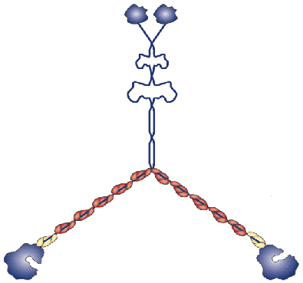
Using in Vitro FIONA to analyze Myosin V movement
37 nm
37/2 nm
x
37-2x
37+2x
Center of mass
0 nm
74 nm
Expected step size
Hand-over-hand:
Head = 2 x 37 nm= 74, 0, 74 nm
CaM-Dye: 37-2x, 37+2x, …
Inchworm: always S_{cm} = 37 nm

Slide 21
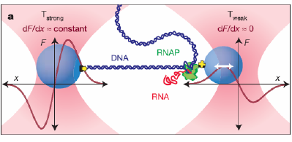
Optical tweezers
(aka. Optical traps, laser tweezers, photonic force microscope, etc.)
Trapping and applications
Principles
Design
– Layout
– Trapping laser
– Objective
Position control
– Stage motion
– Mirrors / AODs / Holograms
Position detection
Calibration
– Position calibration
– Force calibration
Examples

Slide 22
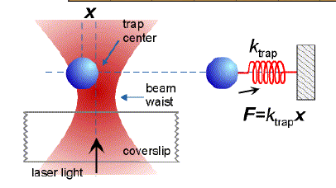
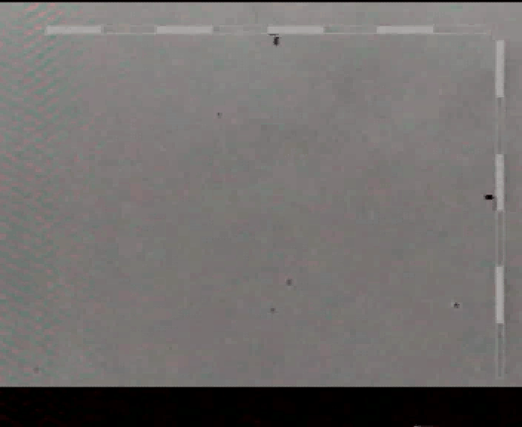
What are Optical Tweezers(OT) ?
Optical Tweezers = Focused Laser beam
OT works by transfer of
momentum
Particles with higher n than surrounding medium are trapped in an approximately harmonic potential
k ≈ 0,001− 0,1 pN/nm
Notes:
The movie shows the trapping of a polysterene bead with single beam laser trap (optical tweezers). The observation direction is opposite to the propagation of the laser beam and in the direction of gravity. The wavelength of the light is 980 nm, the power is 15 mW. The movie is real time. The horizontal length of the viewing area is 44 μm.

Slide 23
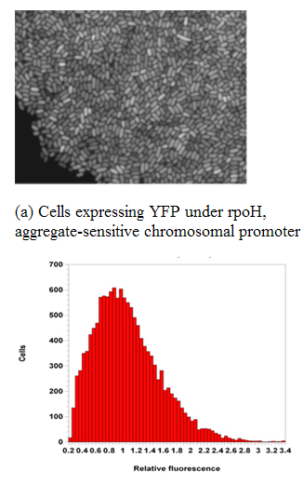
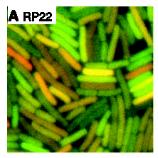
Biophotonics tool in quantitative biology

Slide 24
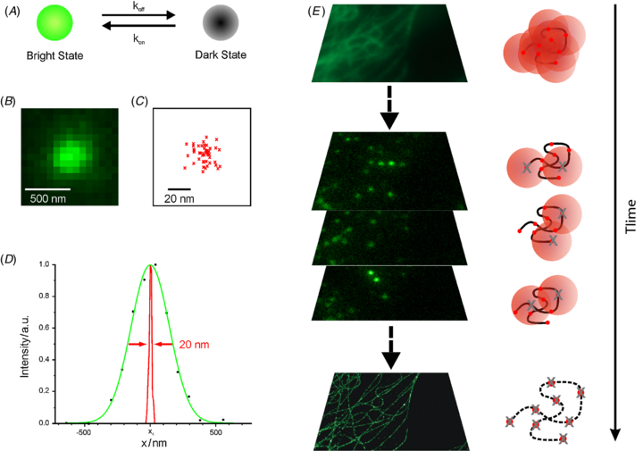

Localization microscopy PALM, STORM, fPALM, SMACAM
Spatial localization accuracy below 10 and Nyquist-Shannon limited resolution of approximately 20 nm
J. Hohlbein et al. Phys. Biol. 7 (2010) 031001 (22pp)
Notes:
Super-resolution microscopy by stochastic photoswitching and single-fluorophore localization. Localization-based super-resolution techniques employ fluorescent probes that exist in at least two discernable states, e.g. a fluorescent (bright) state and a non-fluorescent (dark) state. (A) The transition between these states (photoswitching, photoactivation or photoconversion) is typically controlled via light and/or buffer conditions. (B–D) Emission profile of a single fluorophore in widefield microscopy. (B) Point spread function of a single fluorophore. (C) Both multiple single-molecule localizations with high precision can be approximated with a Gaussian function, demonstrating the increase in spatial resolution (D). (E) Subdiffraction-resolution images are obtained by temporal confinement of fluorescence emission of all fluorophores in a sample, combining stochastic photoswitching with high-precision single-molecule localization.
N is the number of collected photons, a is the pixel size of the imaging detector, is the average background signal and is the standard deviation of the point spread function

Slide 25
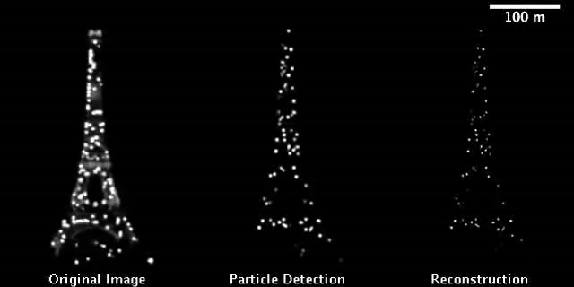
Single molecule localization microscopy
Gaussian spot detection example through QuickPALM - an ultra-fast algorithm for SMLM applied to the PSFs of a common digital camera filming the Eiffel Tower stochastic blinking.

Slide 26
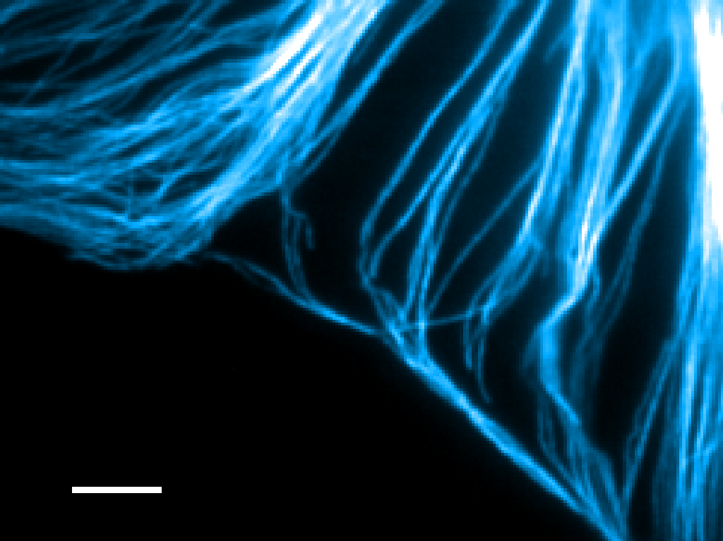
5 μm
B-SC-1 cell,
Microtubules stained with anti-β tubulin
Cy3 / Alexa 647 secondary antibody

Slide 27
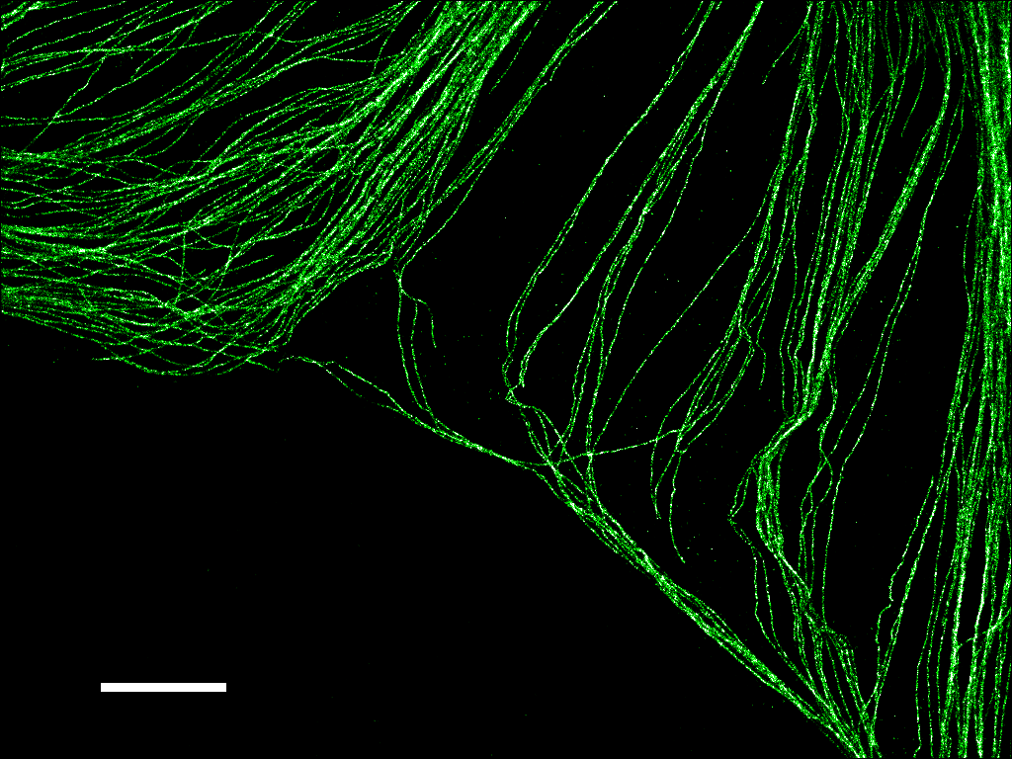
5 μm
Bates et al, Science 317, 1749 – 1753 (2007)

Slide 28
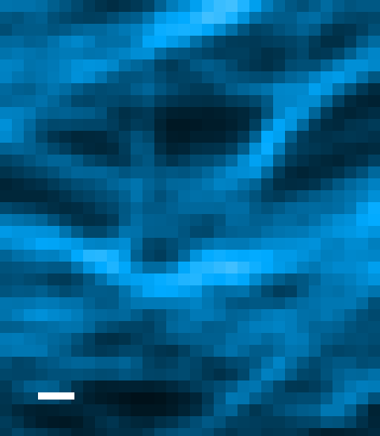
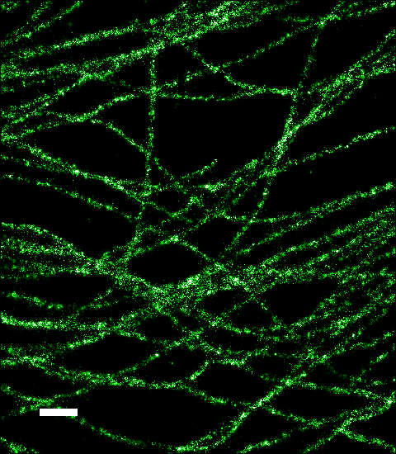
500 nm
5 μm

Slide 29
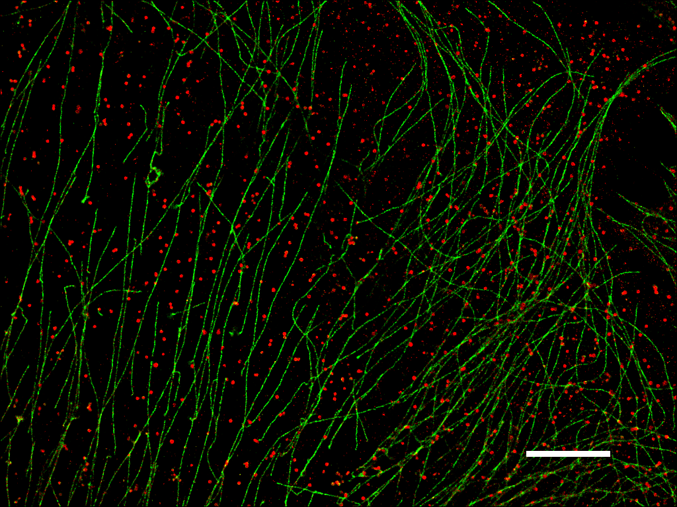
█ Cy3 / Alexa 647: Clathrin
█ Cy2 / Alexa 647: Microtubule
5 μm
Bates et al, Science 317, 1749 – 1753 (2007)

Slide 30
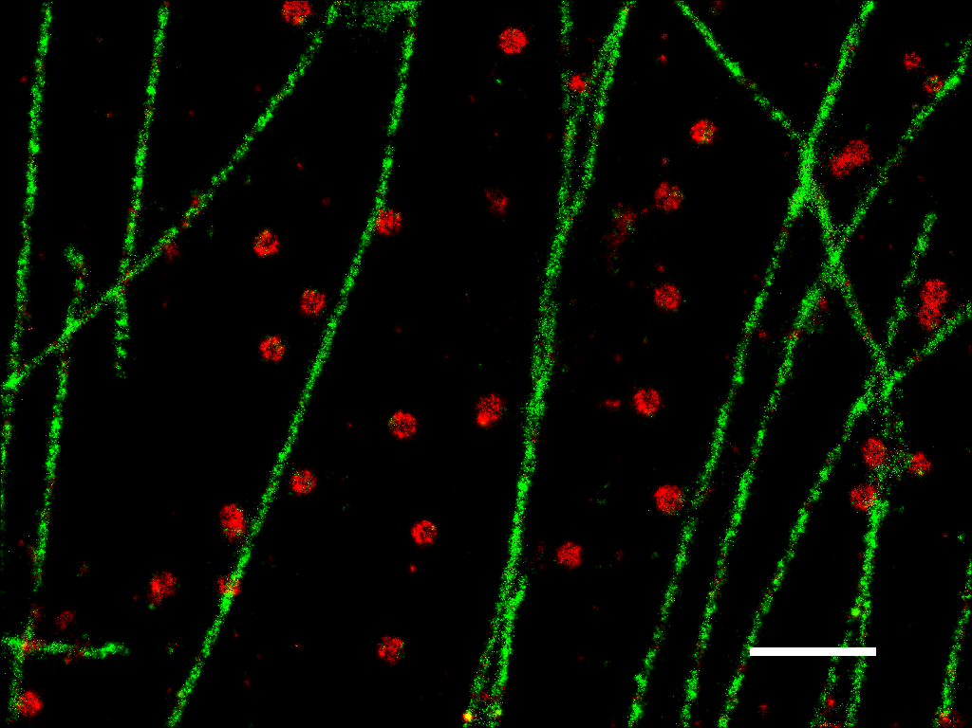
1 μm

Slide 31
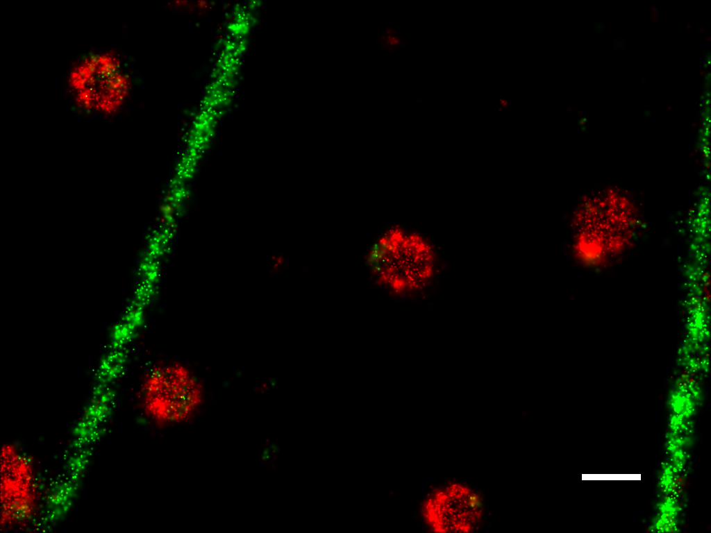
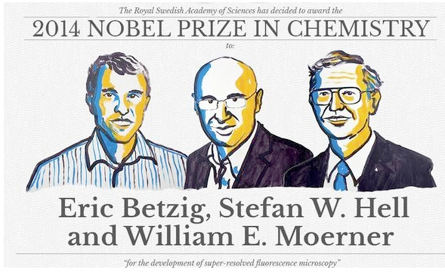
Avg = 172 nm
200 nm

Slide 32
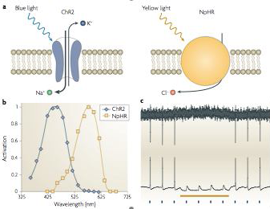
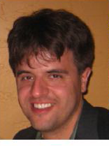
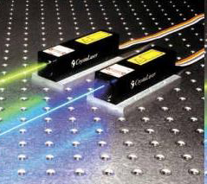
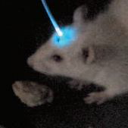
Optogenetics

